Slide 1


Auditions Analysis System
Mehraeel Philip, Fatema Milad, Sama Gehad, Marwan Ahmed, Mo’men Mohie & Jana Ahmed

Slide 2
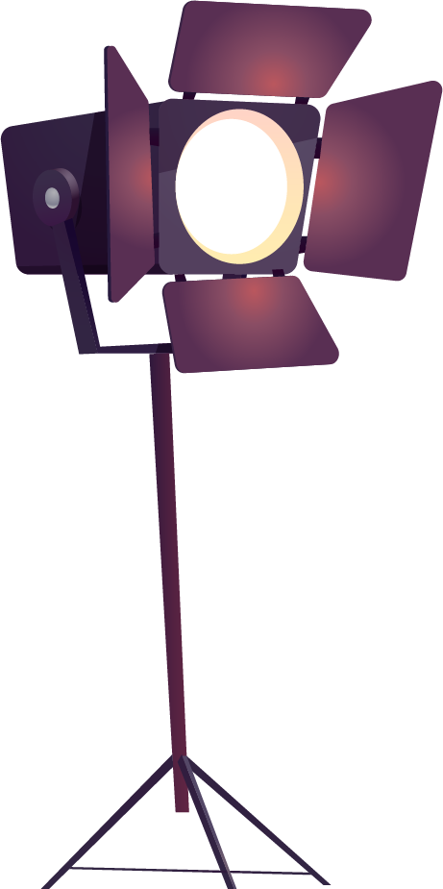

01
Architecture Recap

Slide 3
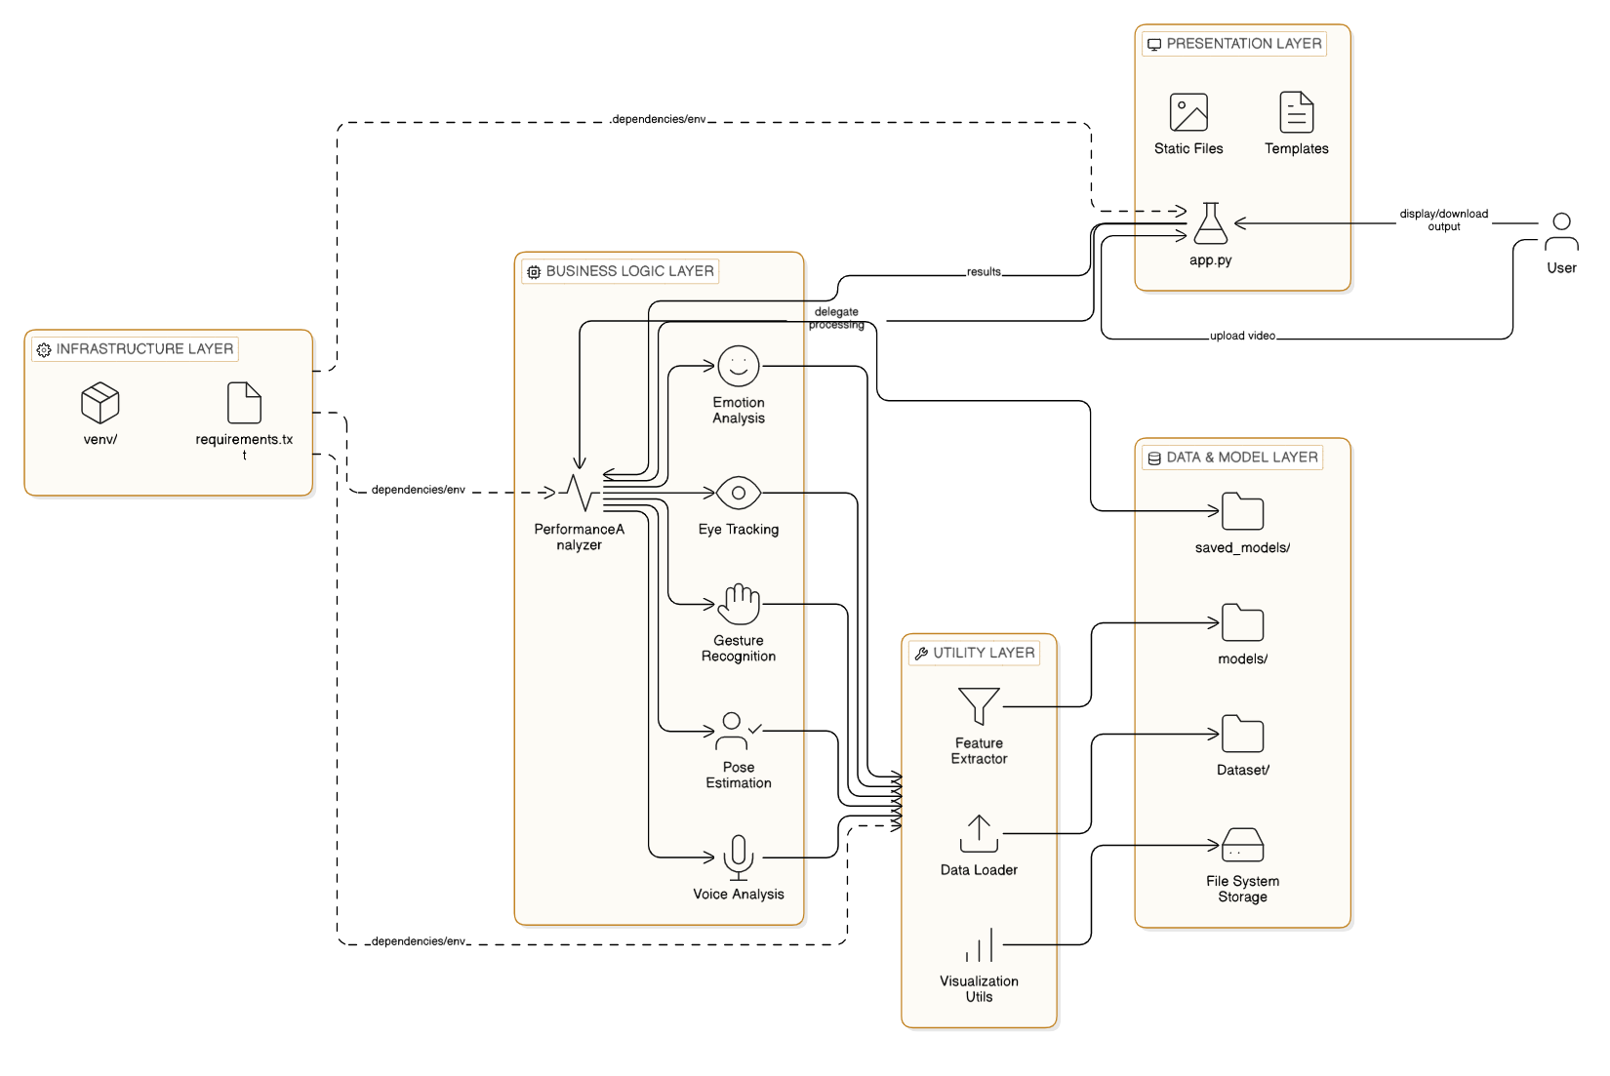
Architectural Diagram

Slide 4

COMPONENT DIAGRAM
Director
Models
Specifications form
Data processing and classification
Auditions
Reports
Uploading or live recording
PDF reports with scoring and evaluation metrics

Slide 5

02
Implementation Overview

Slide 6
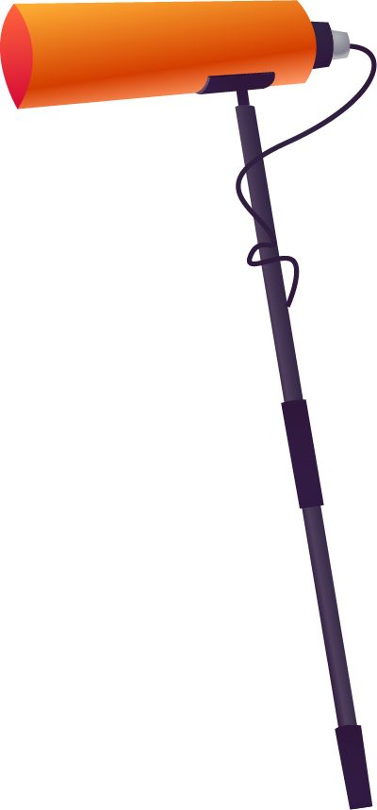
Overview
The project code is organized to specify each functionality in a clear way to ease debugging and developing (OOP). Refinements in branches including ui, reliability and feedback was carried out to improve performance generally executing the functional requirements best approach possible. Design was enhanced based on advices given by doctors and experienced directors.

Slide 7
Implementation Overview – System Workflow
Accepts video input (recorded)
Decomposes video into frames for processing
Frames analyzed using computer vision modules
MediaPipe extracts 2D body landmarks (pose, hands, face)
Landmarks are normalized and structured
Preprocessing includes resizing and noise reduction
Processed data sent to gesture recognition stage

Slide 8
03
Functional Coverage Mapping

Slide 9
FR-01-02 | Video Capture & Audio/Frame Sync — Data Ingestion & Preprocessing | /upload route request.form.getlist() cv2.VideoCapture() | Accepts raw 1–5 minute audition uploads or webcam feeds, extracts 16 kHz audio, and maps synchronized timestamps.
FR-03-07 | Facial, Vocal & Posture Analysis — Per-Modality Analyzers | mp.solutions.pose | Executes localized tracking for eye gaze, Ekman-like facial emotions, speech prosody, and gesture matching via the $1 Recognizer.
FR-07 | Continuous Stream Slicing — Temporal Action Segmentation | recognize() analyze_video() | Segments long video streams into 10 discrete actions, assigning per-segment labels and confidence scores.
FR-08-09 | Director-Facing Reporting & UI — Scoring Engine & Flask UI | chart functions JSON Report VisualizationUtils | Aggregates extracted metrics into numeric scores and 1-3 sentence text summaries, visualized on an interactive web dashboard.
FR-10 | Experiment & Model Tracking — Evaluation Logging | save_results() | Saves evaluation logs, model versions, and confusion matrices to ensure complete reproducibility.

Slide 10
04
Code Structure & Core Modules

Slide 11

System Overview & Code Format
Code Format: The system is primarily written in Python, utilizing popular machine learning and web frameworks.
Core Libraries: It relies heavily on Flask for the web interface, OpenCV and MediaPipe for computer vision, DeepFace for emotion detection, and TensorFlow/Keras for deep learning.
System Use: It is built as an "Acting Performance Assessment System" to provide comprehensive, multi-modal feedback on audition performances.

Slide 12
Architectural Structure
Web Application (web_app/app.py): Acts as the user interface and API backend. It manages video uploads, routes users to reports, and visualizes actor comparisons using matplotlib radar and bar charts.
Analysis Layer (analysis/emotion_analysis.py): Contains specific modules like the EmotionAnalyzer that extract frame-by-frame data (e.g., analyzing angry, disgust, fear, happy, sad, surprise, and neutral expressions).
Machine Learning Layer (models/model_trainer.py): Manages an array of different model architectures. It is responsible for initializing, training, comparing, and saving the models.

Slide 13
Machine Learning Pipeline & Data Flow
Multi-Model Implementation: The code structurally supports 8 distinct machine learning models: CNN-LSTM, LSTM, BiLSTM, GRU, RNN, CNN-RNN, Keras DNN, and PyCaret (Classical ML).
Data Reshaping: Sequence models are structured to automatically reshape flat input data (e.g., transforming features into a (1, features) sequence shape to simulate timesteps).
Ensemble Operation: The pipeline includes a mechanism to aggregate the predictions from all valid models using a voting ensemble and weighted probabilities to generate a final result.

Slide 14




Core Modules:
Unified Feature Extraction Module: Processes raw video and outputs a combined static/temporal data template for training.
Single-Input Inference Engine: Houses 8 sequence-modeling architectures (CNN, RNN, LSTM variants) currently configured to process the unified data format.
Diagnostic & Reporting Module: Generates the performance matrices (Precision, Recall, F1) that highlighted the limitations of the unified input approach.

Slide 15
05
Architecture vs Implementation Alignment

Slide 16
Planned Architecture
The system was designed as a multi-stream architecture:
Flow:
Input → Feature Extraction → Parallel Streams → Fusion Level → Final Prediction → Visualization
Feature Extraction: Uses MediaPipe to extract pose landmarks
Spatial Stream (CNN): Processes posture and gesture (frame-level features).
Temporal Stream (RNN/LSTM): Processes motion across time (sequence-based features).
Fusion Level: Combines outputs from CNN and RNN before final prediction.
Application Layer: Displays results and visualizations.

Slide 17
Mapping Architecture to Code Modules
01
02
03
Data Layer
Feature Extraction Layer
Model Layer
04
05
Business Logic Layer
Application Layer
dataset/, analysis/, test_dataset.py, test_data_loading.py
utils/mediapipe_extractor.py
models/cnn_model.py
models/rnn_model.py
inference.py, debug_model.py
web_app/app.py

Slide 18
Code-Level Explanation
FeatureExtractor (mediapipe_extractor.py)
Inference (inference.py)
* Uses MediaPipe to extract pose landmarks
* Converts them into numerical feature vectors
* Currently merges all features into a single representation
Issue: no separation between spatial and temporal features
* Loads CNN, RNN, and LSTM models
* Runs predictions using the same input features
* Aggregates outputs into a final prediction
Issue: no multi-stream processing or fusion mechanism

Slide 19
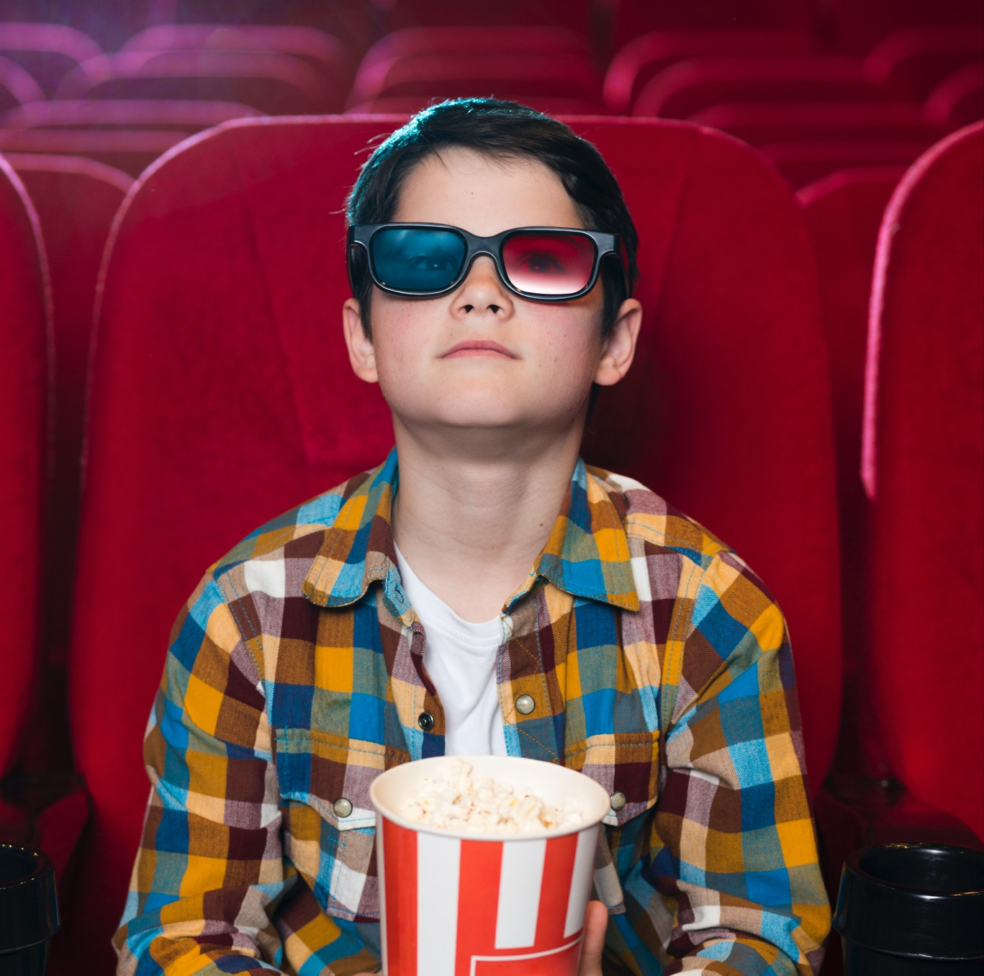
Components Not Yet Implemented:
* Multi-stream architecture (parallel feature processing)
* Fusion layer combining CNN and LSTM outputs
* Separation of spatial and temporal features in feature extraction
* Per-modality evaluation (motion vs posture)
* Dedicated temporal modeling per feature type

Slide 20
06
Design Rationale & Technical Background

Slide 21

Design Rationale - Architecture
Why we chose this architecture ?
Layered architecture ensures clarity and maintainability
Presentation Layer: UI and user interaction
Processing Layer: detection, logic, evaluation
Data Layer: metrics storage and reporting
Separation enables easier debugging and upgrades
Modular design supports flexibility and reuse
Why we chose this design ?
Layered Architecture
|
v
Separation of Concerns
|
v
Modular Components
|
v
Easy Maintenance
|
v
Scalable System

Slide 22
Alternatives Acknowledgement
 | Alternatives | Selected | Justification
Frontend | Flutter, React, etc. | Flask | Web-based UI, system compatibility and API handling
Processing | NumPy & Pandas | Both | Data processing enabling real-time performance and low computational cost
Models | Keras, gru, lstm, etc. | CNN & RNN | Highest accuracy and performance compared to 7 other models
Feedback | Direct classification, technical based | Structured Reports | Enabled scoring and metrics to prove performance instead of direct classification

Slide 23
Technological Background
MediaPipe:
Tracking Engine: MediaPipe serves as the foundation, detecting up to 2 hands per frame and mapping facial topology.
Recognition Method: Uses custom 3D Landmark Heuristics rather than a generic $1 Recognizer, extracting 21 specific coordinates per hand to verify gestures geometrically (e.g., checking if thumb_tip_y < thumb_ip_y for a Thumb Up).
Gesture Scoring Equation: Performance is calculated by combining gesture variety and accuracy: Score = min(Unique Gestures / 5, 1.0) * 0.4 + (Gesture Accuracy) * 0.6.
Normalizing equation to improve consistency:
Normalized x = Actual x (pixel) / Image Width
Normalized y = Actual y (pixel) / Image Height
Used in the Detection Layer.

Slide 24

Technological Background
1$ Recognizer:
Lightweight gesture classification.
The gesture recognition algorithm compares gesture shapes using distance matching.
$d\left(C, T\right)= \frac{\sum_{i=1}^{n}{\sqrt{{(C_{x} [i]−T_{x} [i])}^{2}+{(C_{y}\left[i\right]−T_{y}\left[i\right])}^{2}}}}{n}$
Lower distance means higher similarity between gestures.
Used in the Classification Layer

Slide 25
Technological Background
Machine Learning & AI Ensemble:
Model Architecture: Built on TensorFlow, Keras, and PyCaret, actively managing 8 distinct models that reshape flat data into 3D sequences (samples, 1, features) to simulate timelines.
Ensemble Integration: Combines individual model predictions using a weighted probability average (weighted_proba += weight * proba) and a mathematical Voting System (np.bincount(x.astype(int)).argmax()).
Emotion Performance Metric: Quantifies acting quality mathematically based on the rule that more emotional variation equals better acting:
Score = (Emotion Std. Dev. * 0.5) + (Face Confidence * 0.3) + ((1 - Neutral Mean) * 0.2)

Slide 26
Technological Background
Infrastructure & Data Processing:
Web & Visualization: Uses Flask for the API backend (handling 500MB video uploads) and Matplotlib to dynamically generate radar and bar charts for the UI.
Data Handling: Relies on Pandas to structure multi-frame tracking data (pd.DataFrame) and NumPy for array operations and spatial math.
Mathematical Application: NumPy calculates the exact Euclidean distance between coordinates (e.g., hand and ear)
Distance = np.sqrt((hand_x - ear_x)**2 + (hand_y - ear_y)**2)

Slide 27
07
Evaluation Methodology

Slide 28
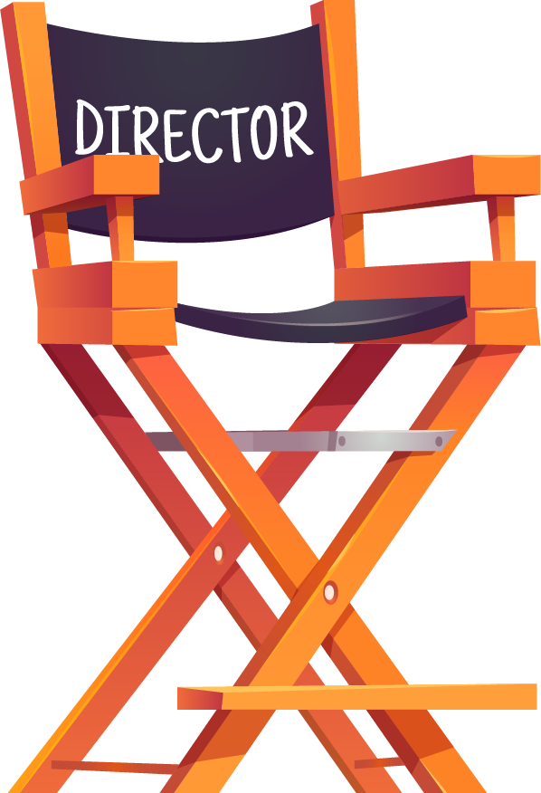
EVALUATION
Comparative baselines
Quantitative
Qualitative
Threats Mitigation
Compared to 7 other AI & ML models to optimive best model.
Metrics such as accuracy, f1 score, precision and recall. To evaluate performance.
Validity Threats
Small sample size, controlled environment and computational power. No experienced director used the system.
Assesment for usability and user satisfaction, enabling feature specification.
Loaded controlled dataset size to manage computational power and increasing dataset size gradually.

Slide 29

08
System Stability, Risks, Challenges &Next Steps

Slide 30
System Stability & Risks
STABILITY:
Uses multiple inputs (video, voice, gestures) → more reliable results
Combines different models to improve accuracy
Clear processing steps keep the system consistent
RISKS:
Depends on good video/audio quality
May not perform the same for every person
Needs high processing power
Limited data can affect accuracy

Slide 31

Challenges & Next Steps
CHALLENGES:
Managing video, audio, and gestures together
Making the system fast and smooth
Limited and complex dataset
Choosing the best model
NEXT STEPS:
Collect more and better data
Improve speed and performance
Fine-tune models for higher accuracy
Improve the user interface

Slide 32
09
Live Demo
https://drive.google.com/drive/folders/1vxdZAUS0mCCJd0KenIfqWXUlbNJ_Howo?usp=sharing

